Slide 1


Airline Safety
By Ravindra Neralla

Slide 2

Transportation Evolution

Slide 3
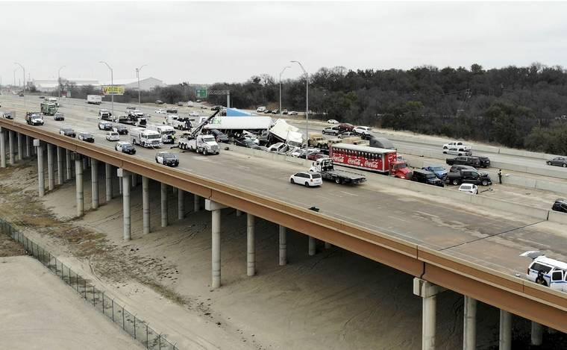
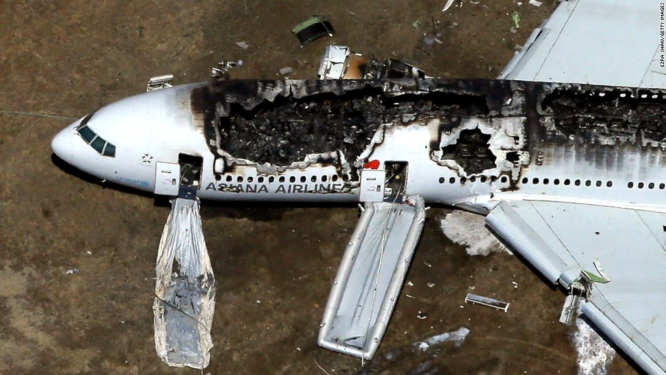
Auto vs Airline Accidents
V
s

Slide 4
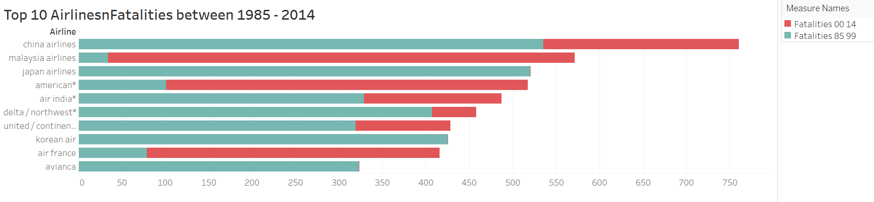
Airline Fatalities between 1985-2014
When we observe the above trend, shows the number incidents and fatalities have reduced over the time.
Decrease in number can be attributed to advancements in technology and safety precautions.
The counts have almost reduced by 50% when we compare the data from 1985-99 vs 2000-14

Slide 5
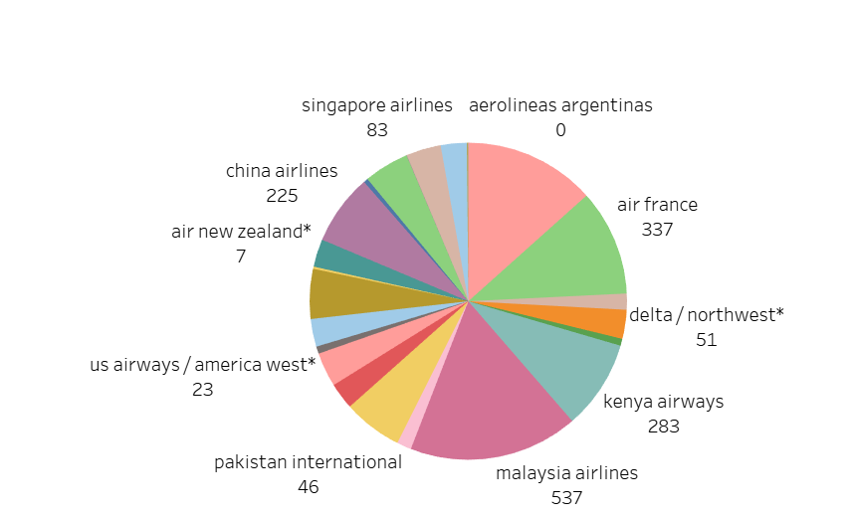
Slide Title
Pie chart clearly shows that Malaysia airlines is at the top, with number of fatalities 537 followed by air France with 337 fatalities.

Slide 6
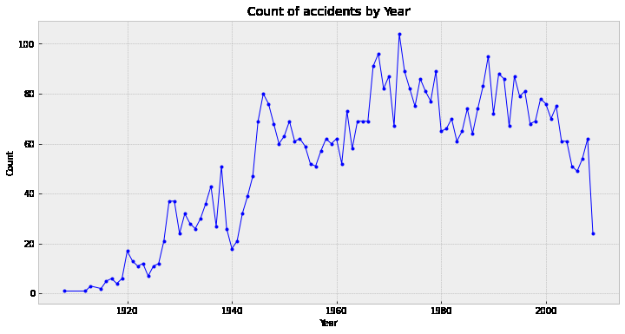
Accidents by Year
Final conclusion is air travel is much safer than car travel.

Slide 7
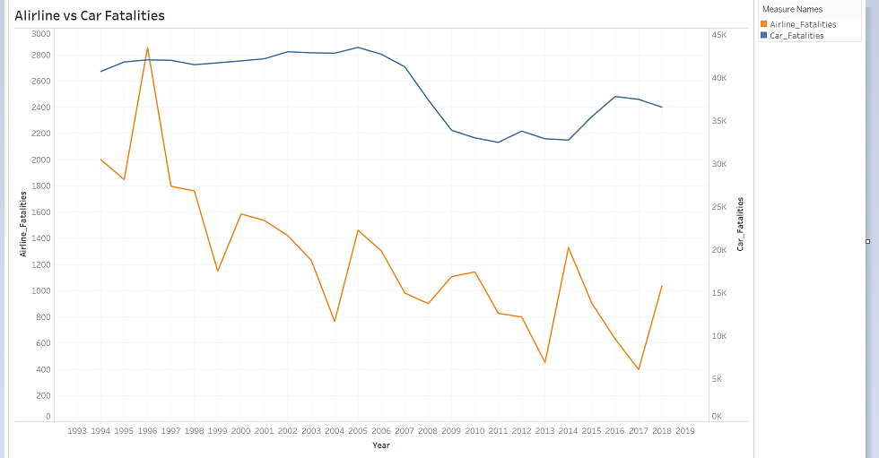
Airline vs Car Fatalities
A clear indication that Airline is the safest mode of transportation.
1995 saw the maximum number of Airline crash – 266.
2005 saw the maximum number of Automobile crash – 39,252.

Slide 8
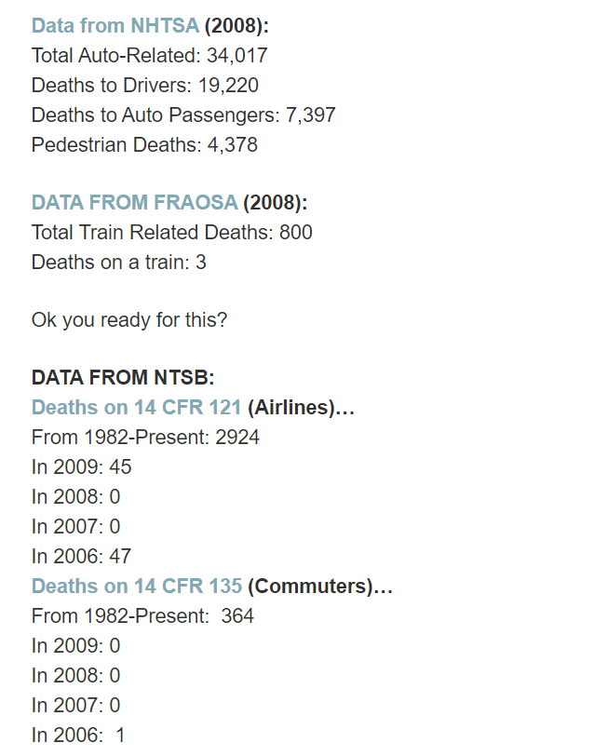
Airline vs Car Fatalities

Slide 9
References
https://catalog.data.gov/dataset/accidents-fatalities-and-rates-1995-through-2014-for-u-s-air-carriers-operating-under-14-c
https://www-fars.nhtsa.dot.gov/Trends/TrendsGeneral.aspx
https://www.bts.gov/topics/airlines-and-airports-0
https://docs.google.com/spreadsheets/d/1SDp7p1y6m7N5xD5_fpOkYOrJvd68V7iy6etXy2cetb8/edit
https://www.airlinereporter.com/2010/09/flying-is-safe-and-i-am-going-to-prove-it/

Slide 10
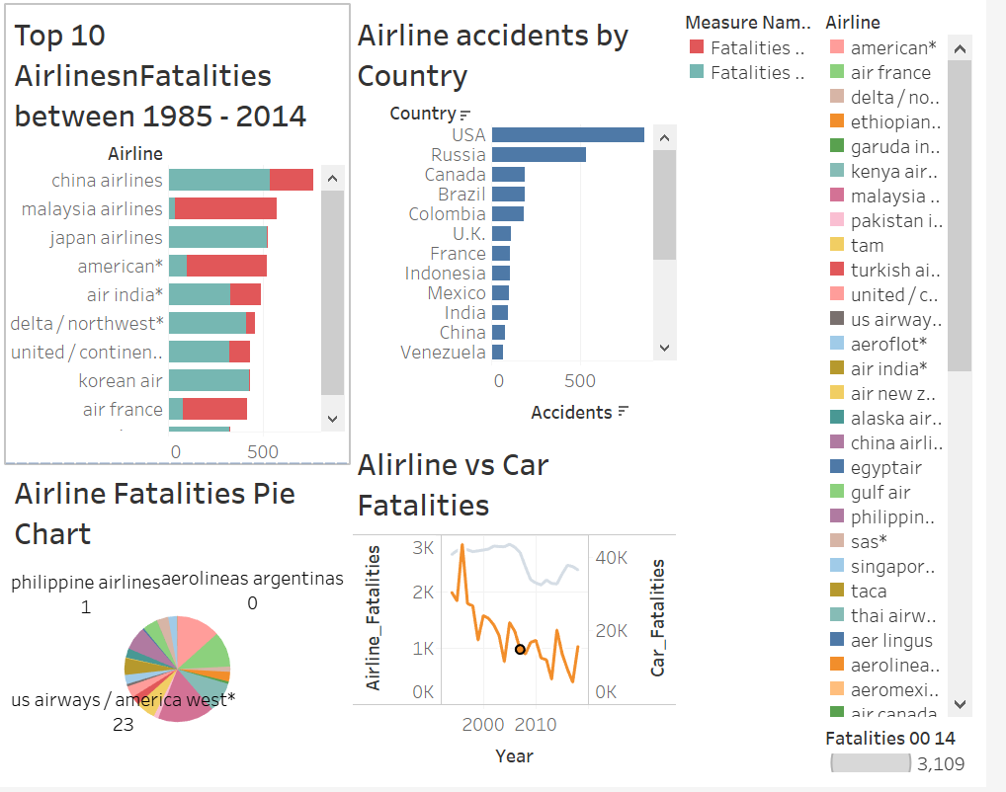
Slide Title
Final conclusion is air travel is much safer than car travel.

Slide 12

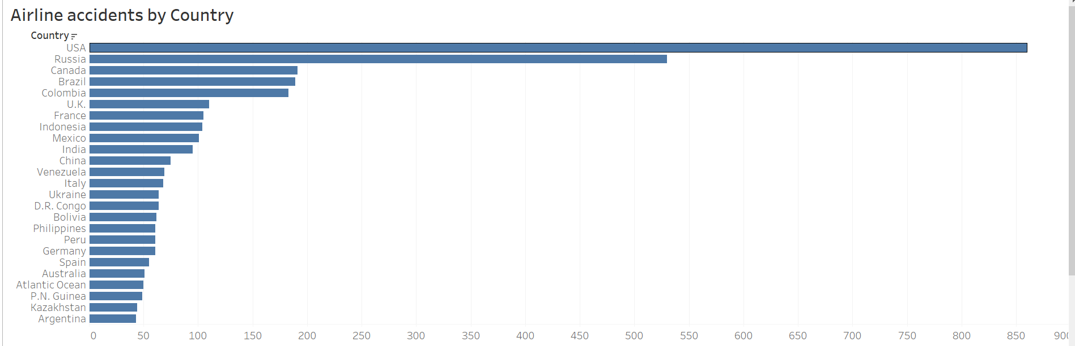
Slide Title
When we observe the number of accidents by country, it shows USA is at top position, this is due to 2001 attack incidents involving serial plane crashes.

